Slide 1
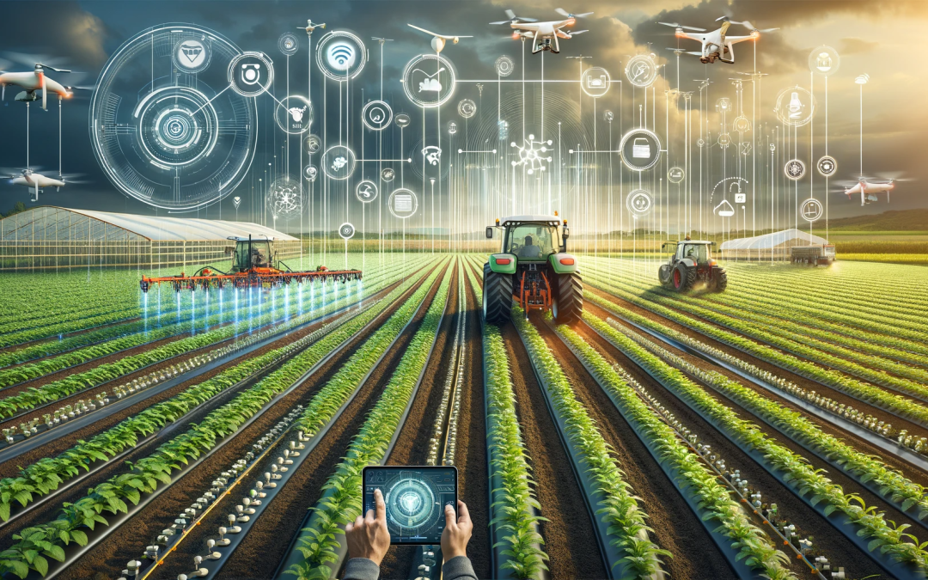
Technology in Agriculture
Martha Portillo

Slide 2
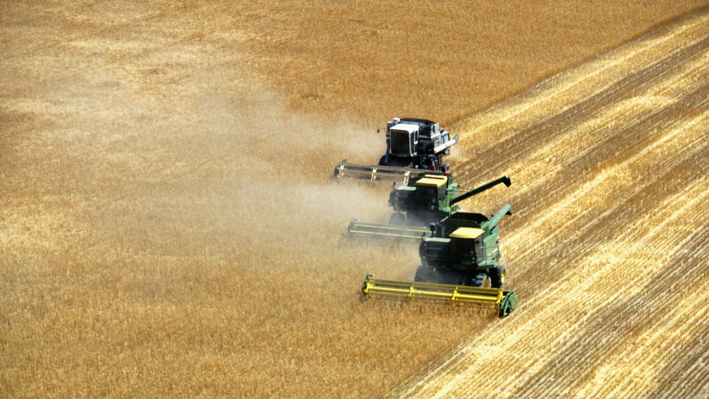
Technology in farming- What is technology?
Technology is seen everywhere in our daily lives. Technology is the application of scientific knowledge to the practical aims of human life

Slide 3
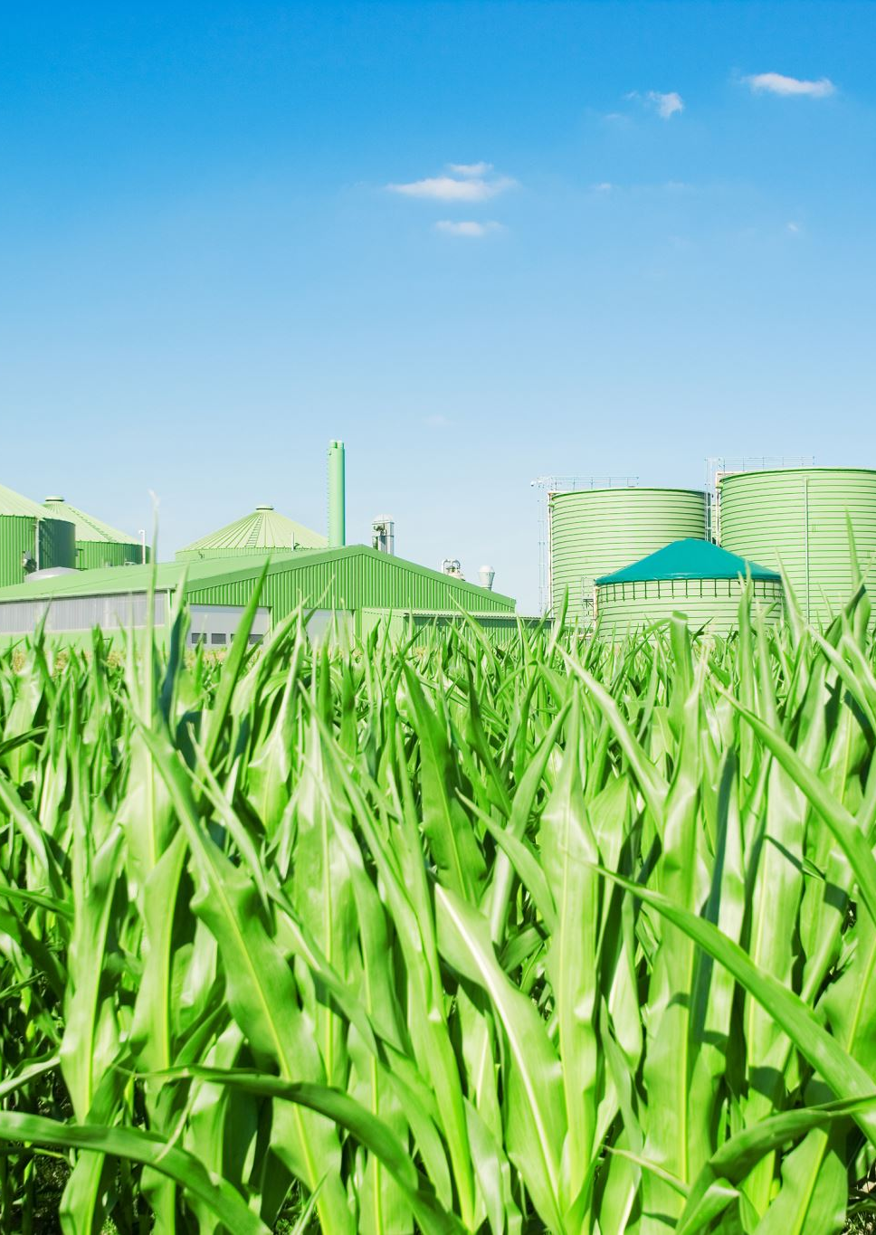
History of Agricultural technology
The history of ecology has gone through four evolutions:
Hunters applying farming
Farming for commerce
Evolution of Machines
Technology developments
4.0 company revolutionized farming by focusing on precision and robotics.

Slide 4
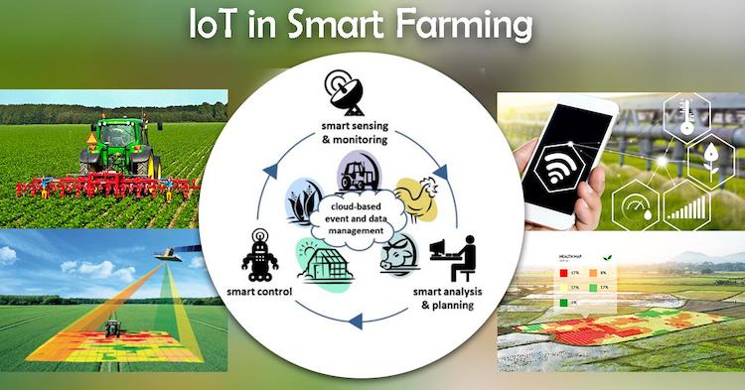
Internet of Things (IoT) & Sensors in Agriculture
The IoT is a network and cloud-based system that connects with "sensors, connected equipment, software and data science to continuously track farming processes." (IoTnow.com) Farmers can monitor soil based on humidity, weather conditions, moisture, plant growth, and even track animal behavior
Thanks to IoT, Sensors will be able to track and receive data from a mobile device or computer to see all data of how much water is required at specific times allowing farmers to create an autonomic schedule. Sensors can also collect soil moisture, temperature and humidity.
Precision Growth rate of +12.9% by 2031 (Martin Lowry,2025)

Slide 5
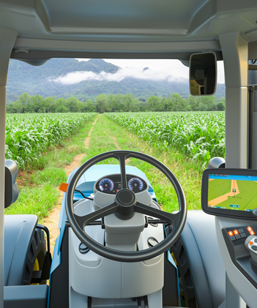
GPS Self-Driving Tractor
John Deere engineers developed the Global Positioning System (GPS) which has the ability of mapping. In agriculture GPS can monitor mass flow (movement of nutrients) and moisture from sensors
GPS self- driving tractors depend on satellite signals to obtain location data to monitor fields, progress and drive on its own by mobile transponders or tags that are attached to an animal, equipment, or around the field to track field location
Farmers can see crop progress, manage water and fertilizers

Slide 6
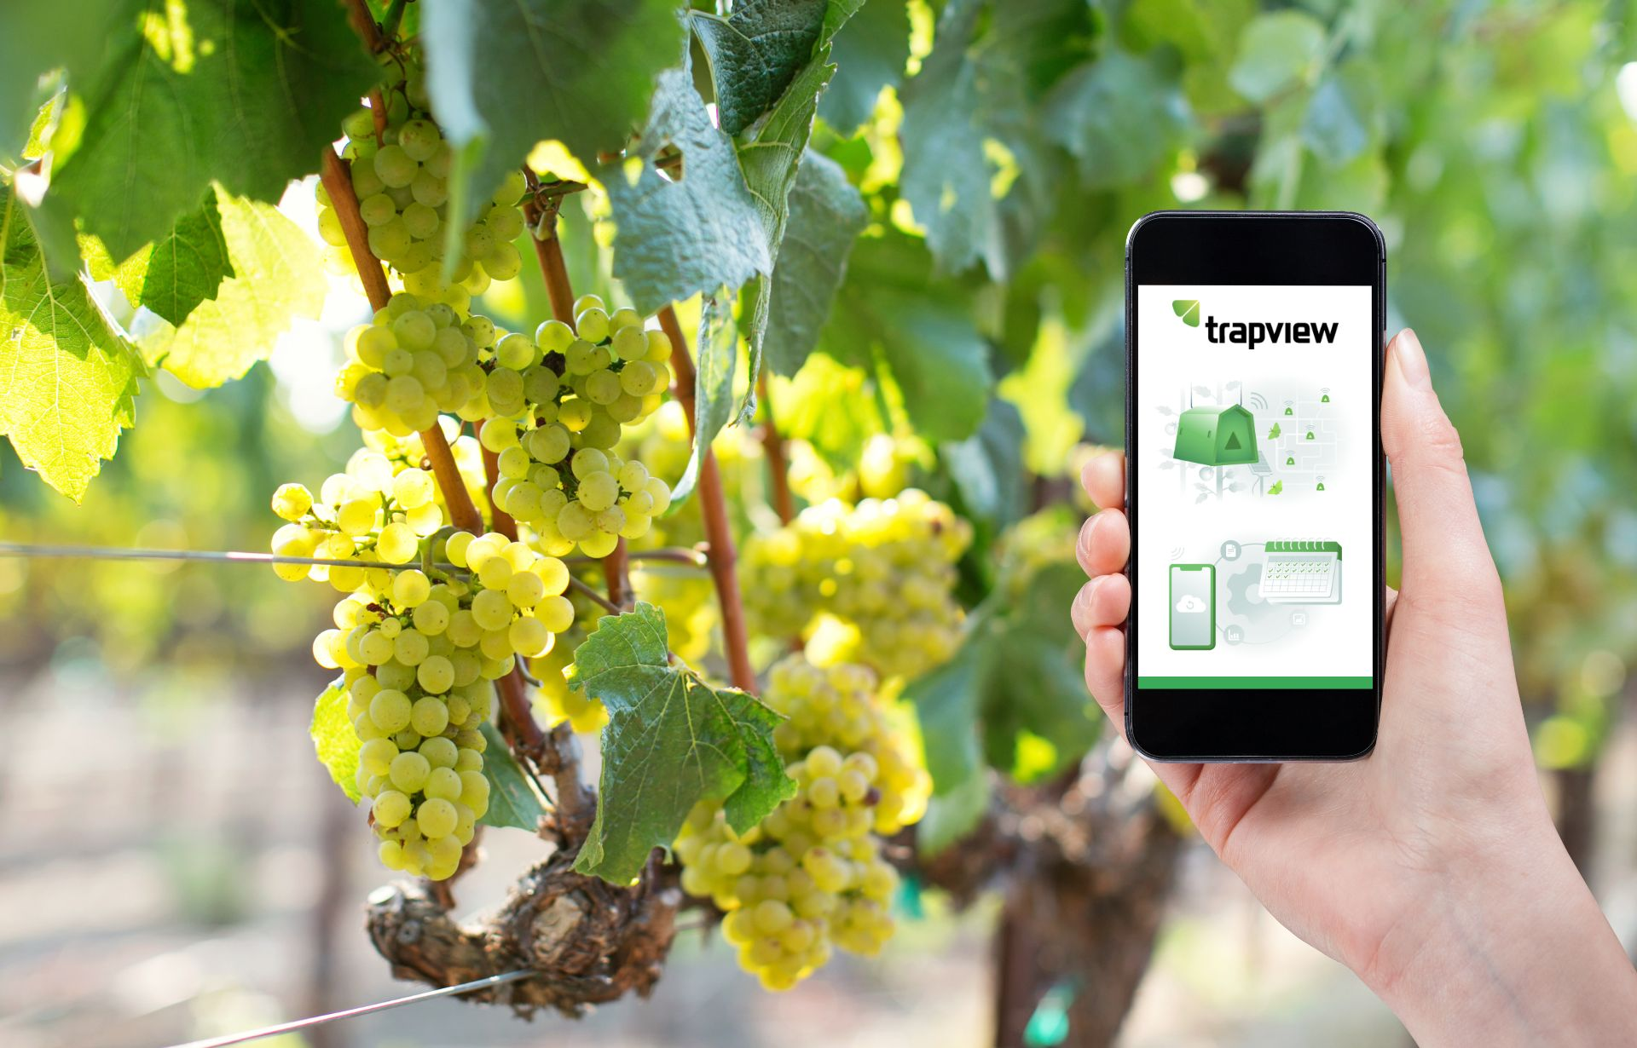
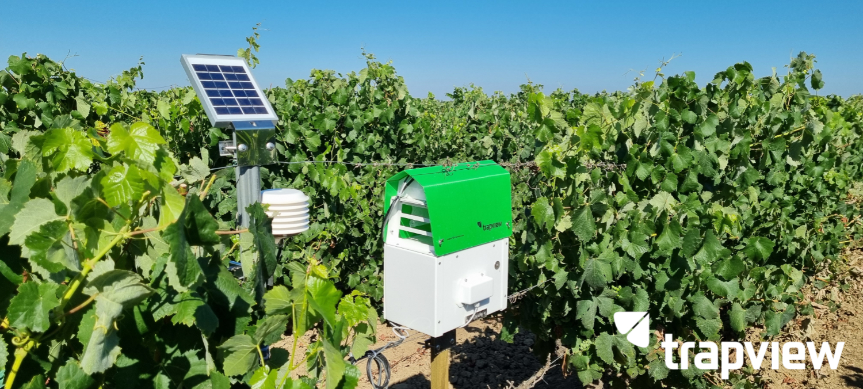
Trapview
New technology of pest traps with clear intelligence, smart reporting and forecasts. Connects to cloud system and receive data from your phone
Photographs and analyzes pests in specific areas of farmer's field and provide guidance and strategies to prevent future pests
According to website Trapview.com, "About 11,882,706 tons of food have been saved"

Slide 7
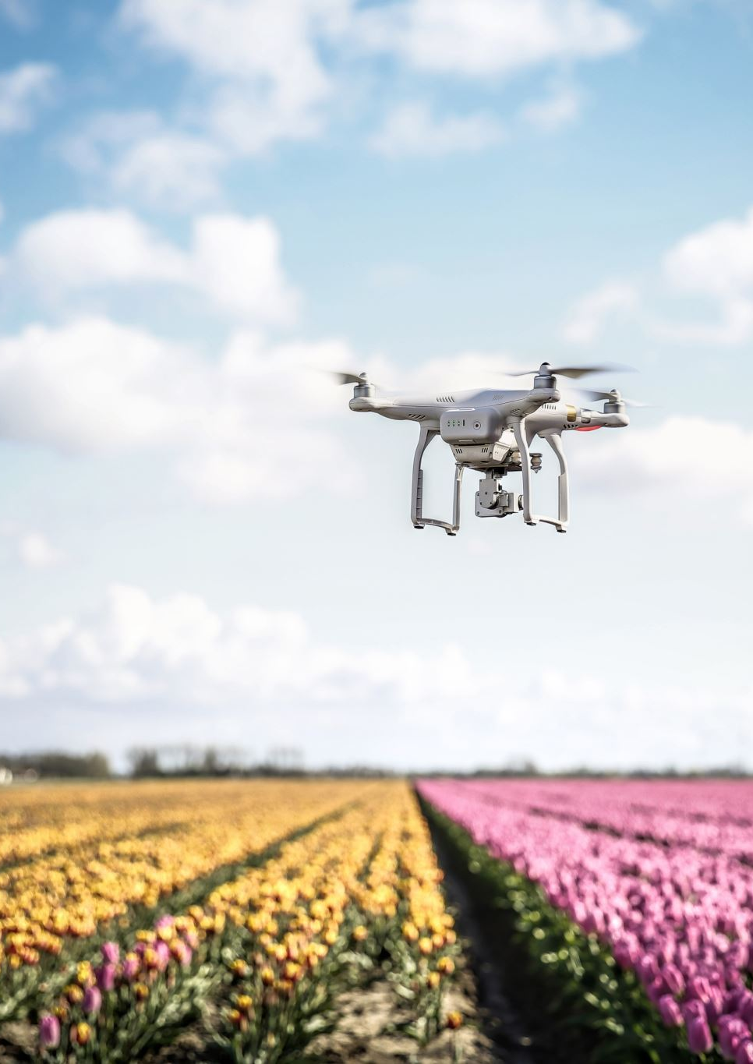
Drones
Drones has become a useful machine that helps farmers keep track of their crops. The Normalized Difference Vegetation Inde (NDVI) monitors crop growth and ensures healthy crops form a high view by using special imaging and colors to detect plant health.
The KRAY technology agricultural is also a self-driving drone that works by spraying fertilizers and pesticides on the fields by spraying in a 3D view as this helps farmers get their crops the exact amount of fertilizer needed, and it could also determine the right time crops will need it.
According to the KRAY technology website, the KRAY drone is “capable to process up to 1,200 acres per day” and can operate at a 70-mph speed which saves the farmers time and money from hiring employees to do the work at a longer time.

Slide 8
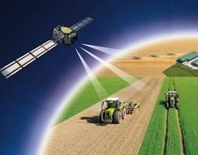
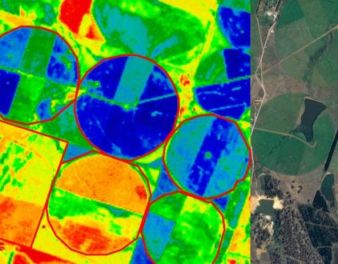
Satellite
Satellite Imagery in agriculture is also a major tool that farmers could use by viewing their crops from a higher point of view than drones of up to 36,000.(Global Center of Adaptation, gca.org)
Although drones can be precise, satellites are also beneficial as it can map ,measure plant growth and monitor the field by looking for drought patterns and recommend how to properly fertilize crops based on weather conditions, soil moisture, canopy density, and chlorophyll content according to ARLULA.com.

Slide 9
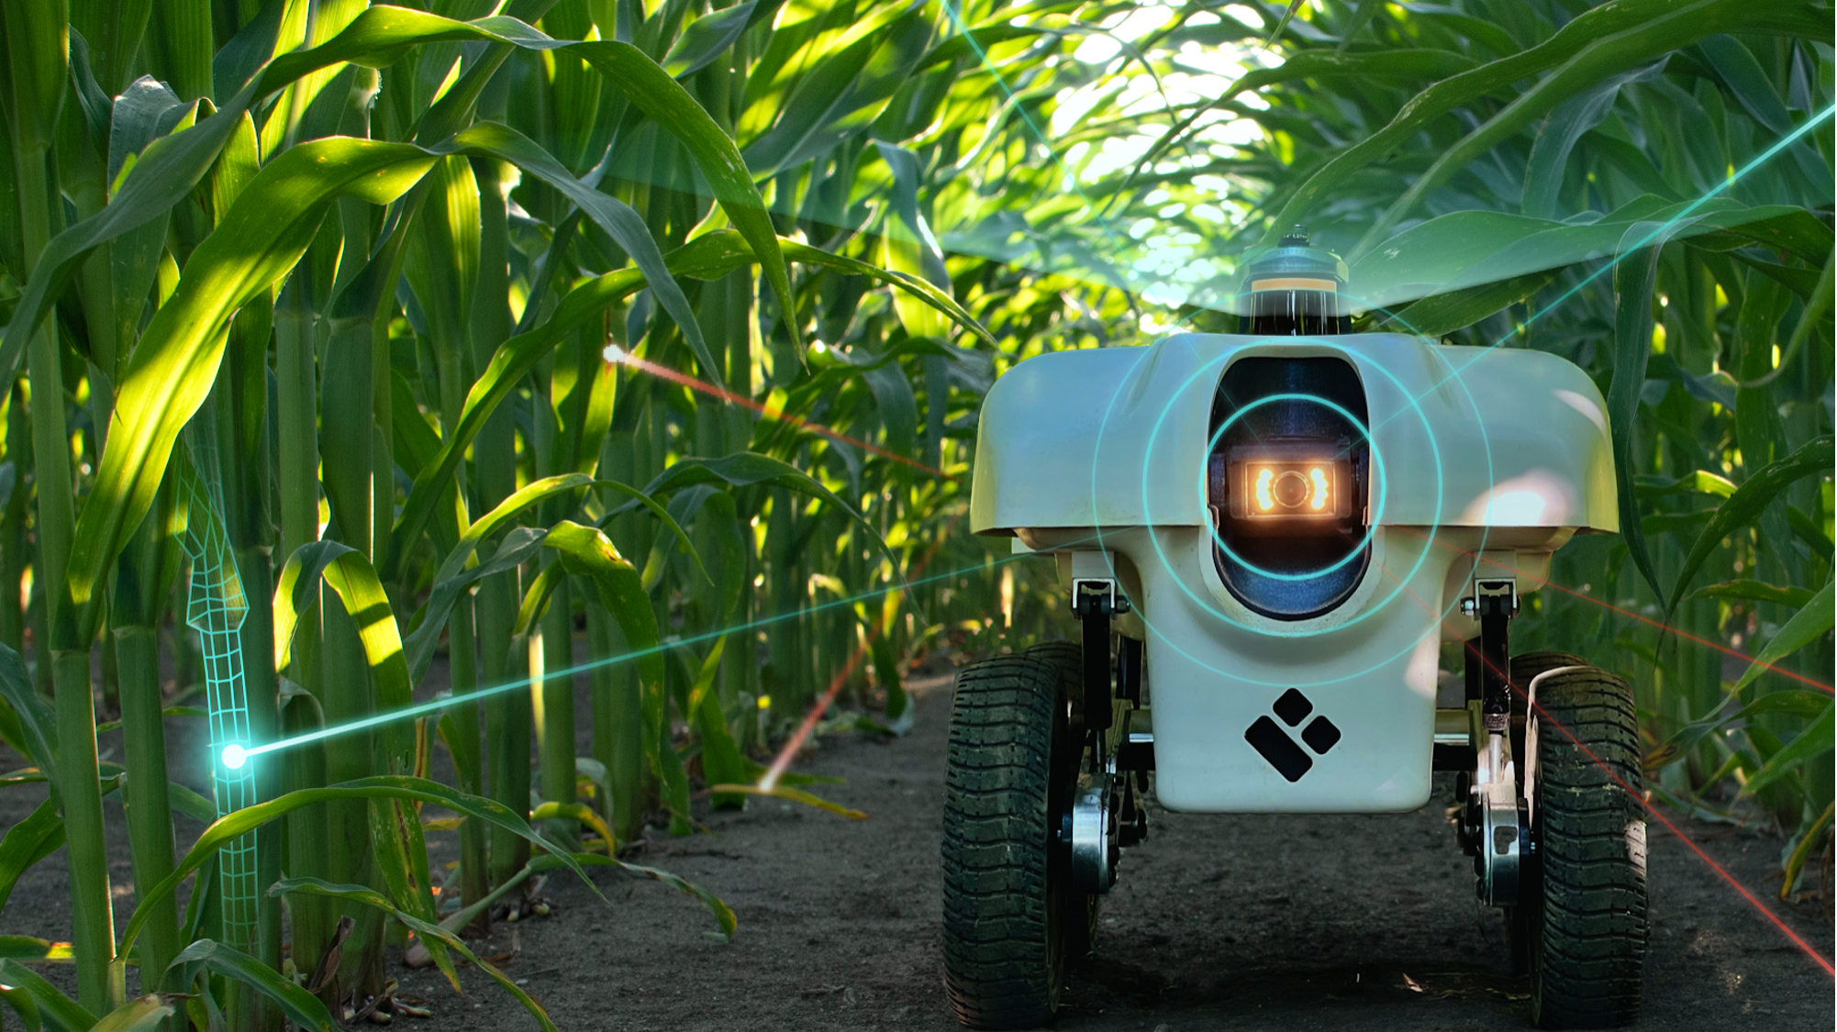
Robots
Agricultural robots can help with planting, picking and packing fruit and vegetables.
Types of robots:
Harvesting robots
Seeding robots
Picking and packing robots
Spraying robots
Monitoring, surveillance robots (livestock)
A robot known as the TerraSentia will walk across the fields with the ability to scan 10 plants per second and receive field data such as stress response by viewing stem width, height and receive plant health according to earthsense.com. These robots are beneficial as it can send reports to your device on how to manage and care for their crops by doing a cloud-based data analysis.

Slide 10
Conclusion
Technology has become essential not only in daily lives tasks but also when it comes to farming. New agricultural technologies have been transformational for farmers and their employees to improve their ways of farming by not having to work hard on farms and spend hours in the sun.
With the help of drones, satellites, and robots, farmers can monitor their crops from inside their homes as well as receive full guidance and strategies to follow to maintain their crops such as vegetables and fruits. By using GPS and IoT, it can provide precision of field data and establish new methods of water usage, fertilizers and pesticides to make higher yields, produce and make less waste with the help of data precision. Self-Driving tractors are also a helpful way for farmers to reduce labor costs or pay employees and replace human labor with self- driving tractors that improve planting by seeding fields with an accurate amount for farmers plant and crops.

Slide 11
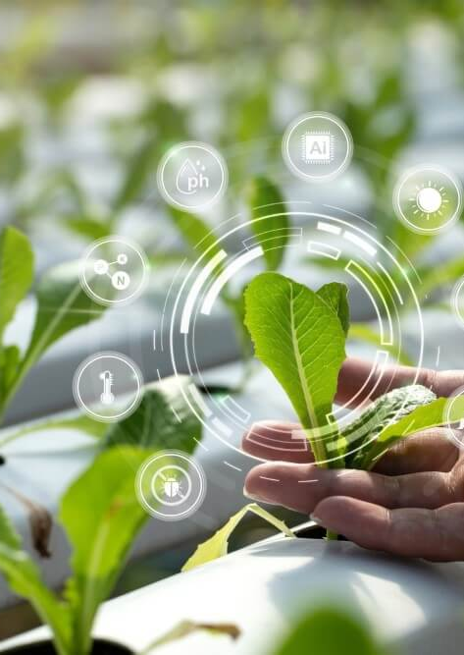
References
IOT now news - how to run an IOT enabled business. (n.d.-a). https://www.iot-now.com/
“Pest Monitoring and Forecasting - Trapview - Integrated Pest Management.” Trapview, 9 Jan. 2024, trapview.com/en-us/. Accessed 04 Apr. 2025. https://trapview.com/en-us/
Arlula. “Why Satellite Imagery Is a Game-Changer for Agriculture.” Arlula, 24 Apr. 2024, www.arlula.com/why-satellite-imagery-is-a-game-changer-for-agriculture/#:~:text=What%20is%20the%20most%20common,diseases%2C%20and%20assess%20crop%20health. . Accessed 04 Apr. 2025.
Cyber-Weld. “Robots in Agriculture and Farming - Robot Welding - Cyber-Weld.” Welding Robot - Photo 1, 13 June 2022, www.cyberweld.co.uk/robots-in-agriculture-and-farming. Accessed 04 Apr. 2025.
“Drone Built to Replace Ag Planes.” Kray Technologies, kray.technology/. Accessed 4 Apr. 2025.https://kray.technology/
Nevin, Padraic. “How Does GPS Guidance Work on Tractors?” Tractor GPS, Tractor GPS, 8 Mar. 2023, tractorgpsapp.com/blogs/articles/how-does-gps-guidance-work-on-tractors. https://tractorgpsapp.com/blogs/articles/how-does-gps-guidance-work-on-tractors
“Agriculture Technology.” Nation Institute of Food and Agriculture, www.nifa.usda.gov/topics/agriculture-technology. Accessed 4 Apr. 2025.
“GPS Correction Technology Lets Tractors Drive Themselves.” NASA, NASA, spinoff.nasa.gov/Spinoff2017/ee_1.html. Accessed 4 Apr. 2025.https://spinoff.nasa.gov/Spinoff2017/ee_1.html
Office, U.S. Government Accountability. “Precision Agriculture: Benefits and Challenges for Technology Adoption and Use.” Precision Agriculture: Benefits and Challenges for Technology Adoption and Use | U.S. GAO, 6 Mar. 2025, www.gao.gov/products/gao-24-105962#:~:text=Technologies%20can%20reduce%20the%20application,Environmental%20benefits. .
https://gca.org/

